Slide 1
Efficient Lead Generation Strategies for Ed-Tech Marketing
Analysis and Recommendations

Slide 2
Introduction
The online Edu-Tech platform that generates leads through various sources. The marketing and sales teams want to optimize their lead conversion rates and improve the efficiency of their lead management process.
The primary goal is to predict whether a lead will be successfully converted into a customer or not.
This prediction can help the Edu-Tech company to prioritize leads with the highest conversion potential and tailor marketing and sales strategies accordingly.
From the given dataset I used the tool power bi to visualize and analyze the lead convertion rates and suggest the steps to improve the marketing.

Slide 3
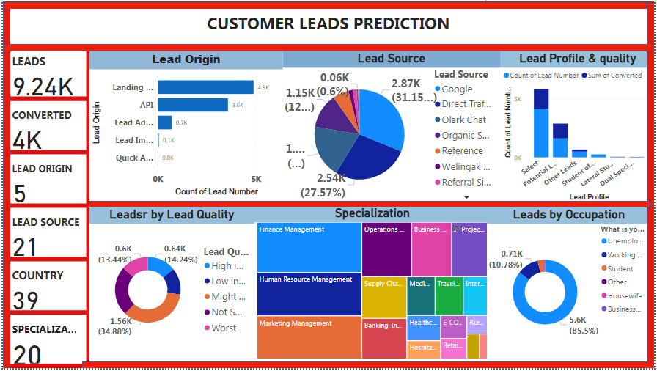

Slide 4
Conversion metrics
From the dashboard we analyze, With 9.24K leads generated and 4K converted, the conversion rate is approximately 43%. Analyzing the drop-off points and optimizing the conversion funnel could further improve this rate.

Slide 5
NURTURING SOURCES
Focus on High-Performing Lead Sources: Google, Direct Traffic, and Olark Chat are the top three sources of leads. Increasing investment in these channels could potentially increase lead generation.
Improve Lead Quality: A significant number of leads are marked as 'Not Sure' in terms of quality. Implementing better lead qualification processes could help in converting more leads by focusing on those with higher relevance.
Specialization and Occupation Targeting: Specializing marketing efforts based on the most popular specializations and targeting occupations like students could be more effective.

Slide 6
Lead Origin Analysis
Landing Page Submission is the most significant source of leads, suggesting that optimizing the landing page could further increase lead generation.
API and Lead Add Form also contribute to lead generation but to a lesser extent. Enhancing API integration and form design might improve conversion rates.

Slide 7
Lead Quality and Activity Insights
Asymmetric Activity Scores indicates that leads with Medium and High Activity Index have higher engagement. Focusing marketing efforts on activities that increase user engagement could lead to higher quality leads.
Lead Quality data shows a significant portion of leads are High in Response. Tailoring follow-up strategies for these leads could improve conversion rates.

Slide 8
Lead Sources
Google and Direct Traffic are the top sources for leads. Investing more in SEO and online advertising could capture more high-intent leads.
Olark Chat and Organic Search are also notable sources. Enhancing chat support and maintaining strong SEO practices are recommended.

Slide 9
Specialization and Targeting
The data on Specialization suggests tailoring marketing messages based on the prospective student’s area of interest could be effective.
Country and City data can be used to localize marketing campaigns, which could be more resonant and effective.

Slide 10
Conclusion and Recommendations
The strategies include enhancing lead nurturing, personalized communication, timely responses, multi-channel engagement, lead scoring and segmentation, feedback collection, and continuous improvement. These strategies aim to improve engagement and conversion rates for high-response leads.

